Slide 1

Predictive Analytics Course Project
Predicting Users at Risk of
Leaving due to Personal Data Use
Natallia Casey
Bellevue University, Nebraska

Slide 2
Objectives
Predict users who are at risk of leaving
Understand the reasons for departing
Determine how educated people are about data use
Discover patterns in people’s behavior
Suggest how to fix it

Slide 3
Steps
1
Business Problem Understanding
2
Data Understanding
3
Data Preparation
4
Modeling
5
Evaluation
6
Recommendations for Deployment

Slide 4
Problem Statement
Overview
Why?
Customer churn obstructs growth:
user retention costs less than user
acquisition
Rate of customers leaving due to
personal data use is high
Personal data use can significantly
improve the quality of a product
Personal data use is a complex
problem and needs to be
examined from various perspectives
The amount of personal data used
increases every year.
A widespread concern is present
over privacy protection, ethical
misconduct, breech of regulations
by companies using consumers’
personal data.
Understanding users’ behavior and predicting people’s departure could have practical benefits for both the companies and their customers

Slide 5
Data
Survey (June 2019)
conducted in English and Spanish
randomly selected adults from households of 50 US states
by Internet
survey weights applied
margin of sampling error is ± 1.87 percentage points
questions about “Privacy and Surveillance”
audited for any patterns of satisficing
143 variables and 4272 observations
main data type – categorical
Data Source
American Trends Panel Wave 49
https://www.pewresearch.org/internet/dataset/american-trends-panel-wave-49

Slide 6
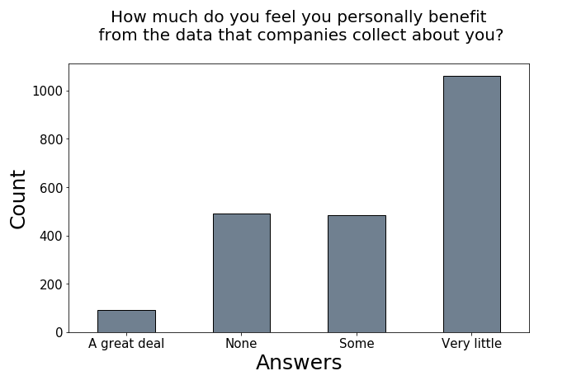
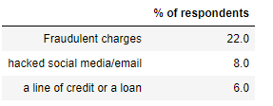
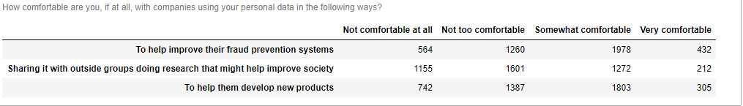
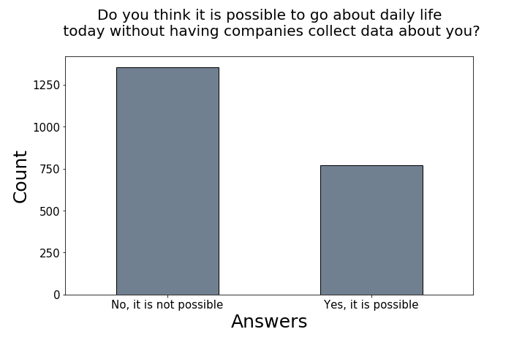
Why stop using a service?
22% of respondents had fraudulent charges put on
their debit or credit cards within the last 12 months.
Most of the respondents think they have little benefit from the data collected by the companies.
What do people think?
Very few respondents are very comfortable with companies using their data, especially when sharing it with outside groups. Fraud prevention is the most favored reason to share personal data.
More respondents believe it is not possible to go about daily life without personal data collection by the companies.

Slide 7
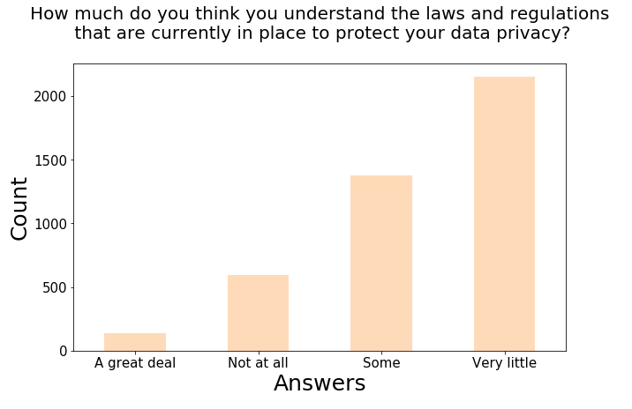
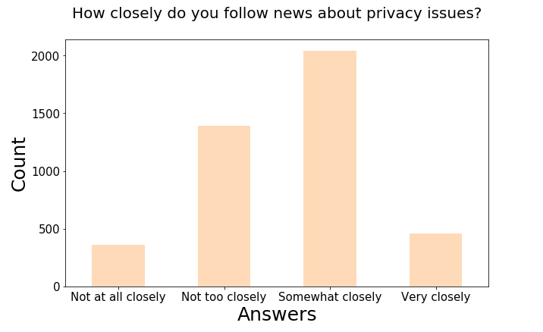
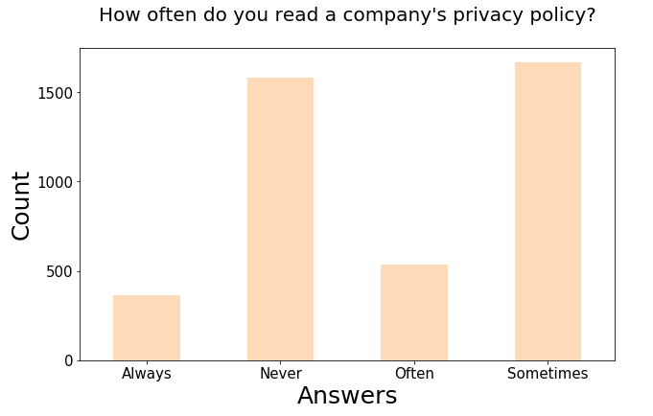
How educated are
respondents about data use?

Slide 8
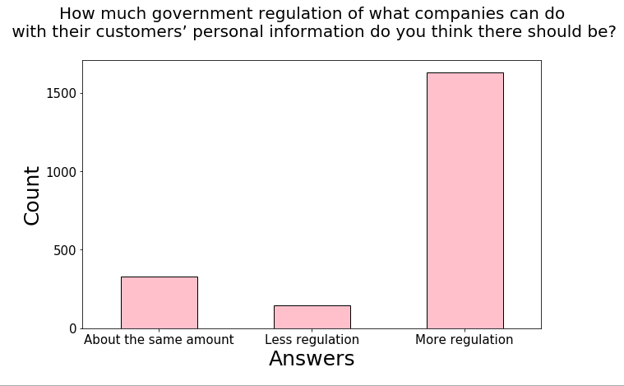
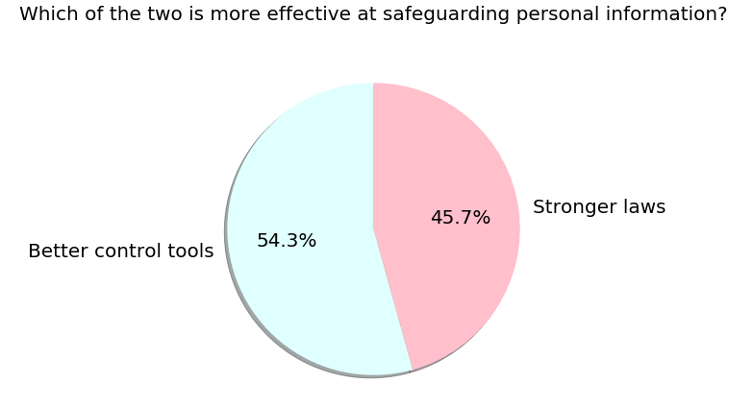
What needs to be done: respondents’ opinions
Overwhelming support for the need of more regulation has been expressed by the respondents
Better tools for allowing people to control their personal information themselves is a more popular choice than stronger laws

Slide 9
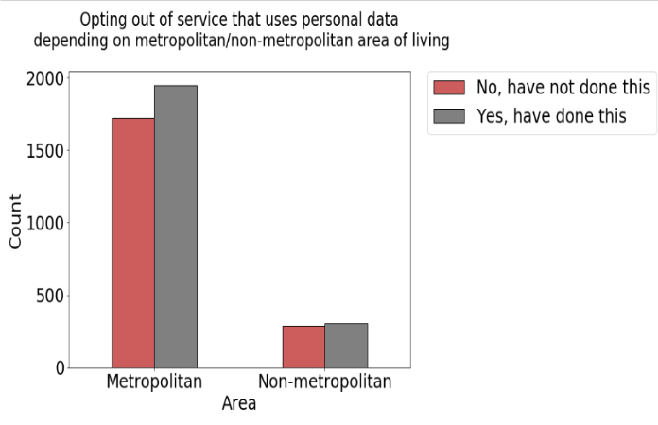
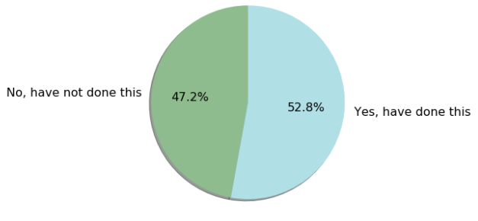
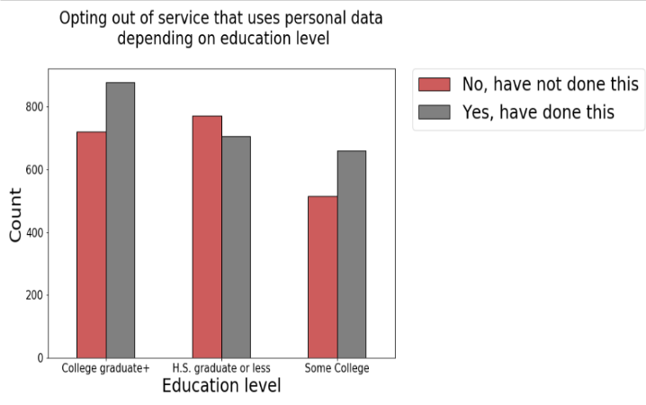
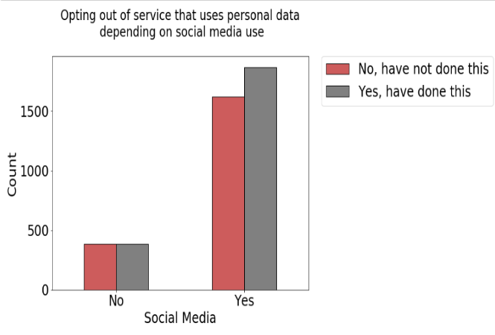
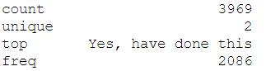
More respondents that have opted out of using a service due to personal data use live in the metropolitan area rather than non-metropolitan one.
Target variable
Have you recently decided NOT to use a service or product because you were worried about how much personal information would be collected about you?
More respondents with some
college and those with
graduate degree have
opted out of a service than
those with high school diploma or less
The classes of the target variable are well balanced
Summary Statistics
More respondents using social
media have opted out of a
service than those who are not social media users

Slide 10
Features
Selection of features was based on whether all participants were asked a question and whether the data could be measured by companies in the future. Thus, the features mostly include the devices use and demographic information.
TRACKCNT-W49 – number of devices used that utilize personal data
LOYALTY_W49 – member of a loyalty program
SNSUSER_W49 – social media use (yes/no)
F_CREGION – region of the country
F_METRO – metropolitan or non-metropolitan area of residence
HOMEASSIST1_W49 – voice control speaker use (yes/no)
F_AGECAT – age*
HOMEIOT_W49 – smart devices use at home (yes/no)
F_SEX – gender*
F_MARITAL – marital status (married/not married)
F_ACSWEB – access to Internet
FITTRACK_W49 – smart watch or a wearable fitness tracker (yes/no)
F_EDUCCAT – education level
F_INCOME_RECODE - income
SMARTPHONE_W49 – smartphone use (yes/no)
F_VOLSUM – volunteer or not
*decision was made to keep variables F_AGECAT and F_SEX since additional weighting variable was added to the sample that is meant to fairly represent the classes within these categories. The nature of research is assistive where the results are meant to help with establishing positive relationship between a user and a service provider, and not in any way to restrict.

Slide 11
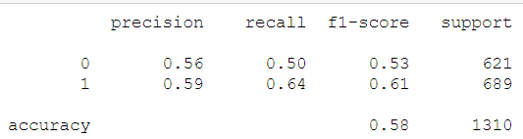
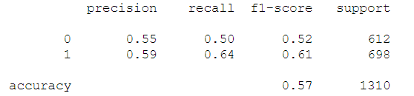
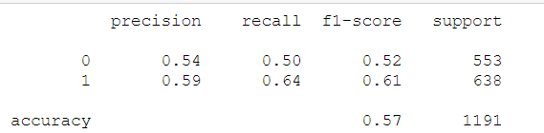
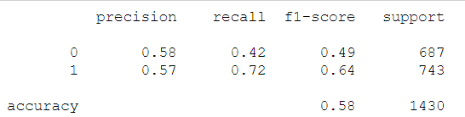
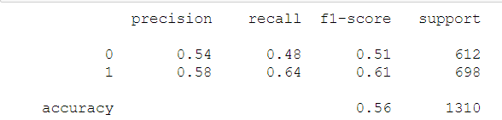
Models
Extreme Gradient Boosting
Support Vector Clustering
Random Forests Classifier
Neural Network Classifier (Keras)
Logistic Regression Classifier
Recall of the positive class is the main metric for assessment because we are primarily interested in identifying users that won’t use the service. The EDA analysis has shown a lot of the users are not well educated about personal data use, and if some of the incorrectly identified users receive marketing messages, they might simply benefit from more information about personal data use.
Get a modern PowerPoint Presentation that is beautifully designed. Easy to change colors, photos and Text. You can simply impress your audience and add a unique zing.

Slide 12
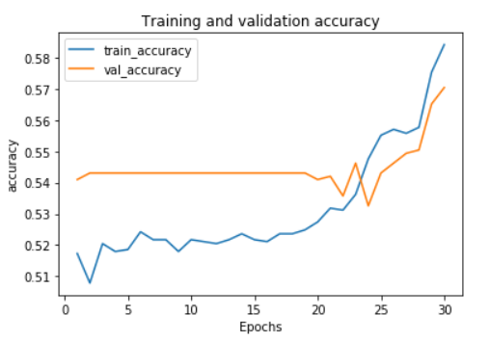
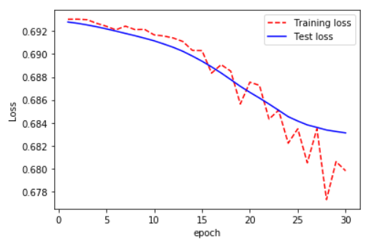
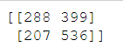
Neural Network Classifier (best performing model)
We can see that the training accuracy is higher than the validation one after some training, yet remaining pretty similar to one another. Both testing loss and training loss are continuously decreasing. The model is not overfitting. (Regularization and hyperparameter tuning were applied to the final model)
Confusion Matrix

Slide 13
Recommendations for Deployment
More features could be added to the model to make it a stronger classifier
Larger sample size could help with improving the predictions as well.
Model is especially useful for companies using loyalty programs and devices using personal data
Ensuring reproducibility relying on the information provided in the tech report is
important

Slide 14
Results
Recall 72%
The Model
The Neural Network Classifier had the accuracy of only 0.58. The recall for the positive class is at 0.72 which means that the model classified more than two thirds of the users that did not use the service due to personal data use correctly, which is better than random guess and could be useful.
Insights
About 36% of respondents have been victims of some sort of personal data misuse.
People do not believe there is much benefit from the personal data use yet they acknowledge that it is not possible to go about daily life without
personal data use.
Majority of people want more government regulation over the personal information use.
They believe tools that would let them control personal data use themselves are more effective
Majority people do not understand the current laws of data protection, yet they express interest about the current state of personal data use and
regulations.
Most of the people do not read companies’ privacy policies.
The highest concern is about the amount of information advertising companies know;
People are least comfortable when sharing their data with outside groups.

Slide 15
Recommendations for Companies and Limitations of the Project
 | Recommendations: People identified as the ones likely to stop using the service could be sent informational messages with simplified descriptions of personal data use protection measures. Easy to understand information should be available for the general public to increase public awareness of various privacy policies and safety measures used by a company. After using marketing means to address the issue uplift model could be used to further improve the results of churn predictions. Limitations of the project A lot of the potential predictors were not used due to the fact they would be hard to measure by businesses Interpretability of the neural network algorithm is challenging. | Recommendations: People identified as the ones likely to stop using the service could be sent informational messages with simplified descriptions of personal data use protection measures. After using marketing means to address the issue uplift model could be used to further improve the results of churn predictions. Larger sample size and additional features added by companies could improve the predictions. Limitations of the project A lot of the potential predictors were not used due to the fact they wouldn’t be possible to measure by businesses Interpretability of the neural network algorithm is challenging.

